Slide 1
presents

Slide 2
Challenge Types
These tasks are all about trying to beat your high score and be the best you can be! Don't worry if it's hard at first, practice makes perfect!
These competitions are ones you can take part in to help your school climb up the scoreboard, so give it your all in this huge team effort! It's all about participation!
These challenges will require you to get your problem-solving hat on and show us some of your creative ways to get active, remember to think outside the box!
Notes:
Hit targets of daily programme of activities, provide daily inspiration & hit objectives of teaching not just physical fitness but physical literacy, problem solving and personal challenges. Social aspect via online displays instead of classroom displays. Challenges to be developed from existing content + own variations, be promoted using the key hashtags etc.

Slide 3
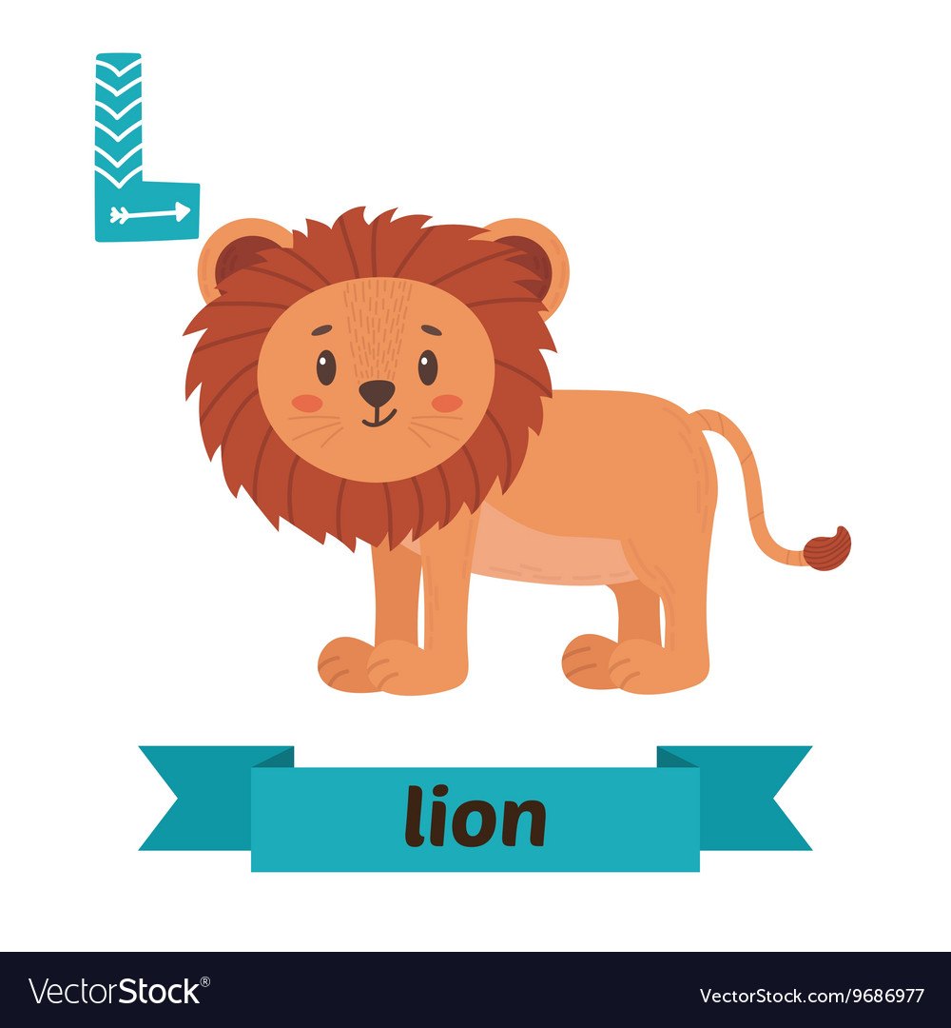
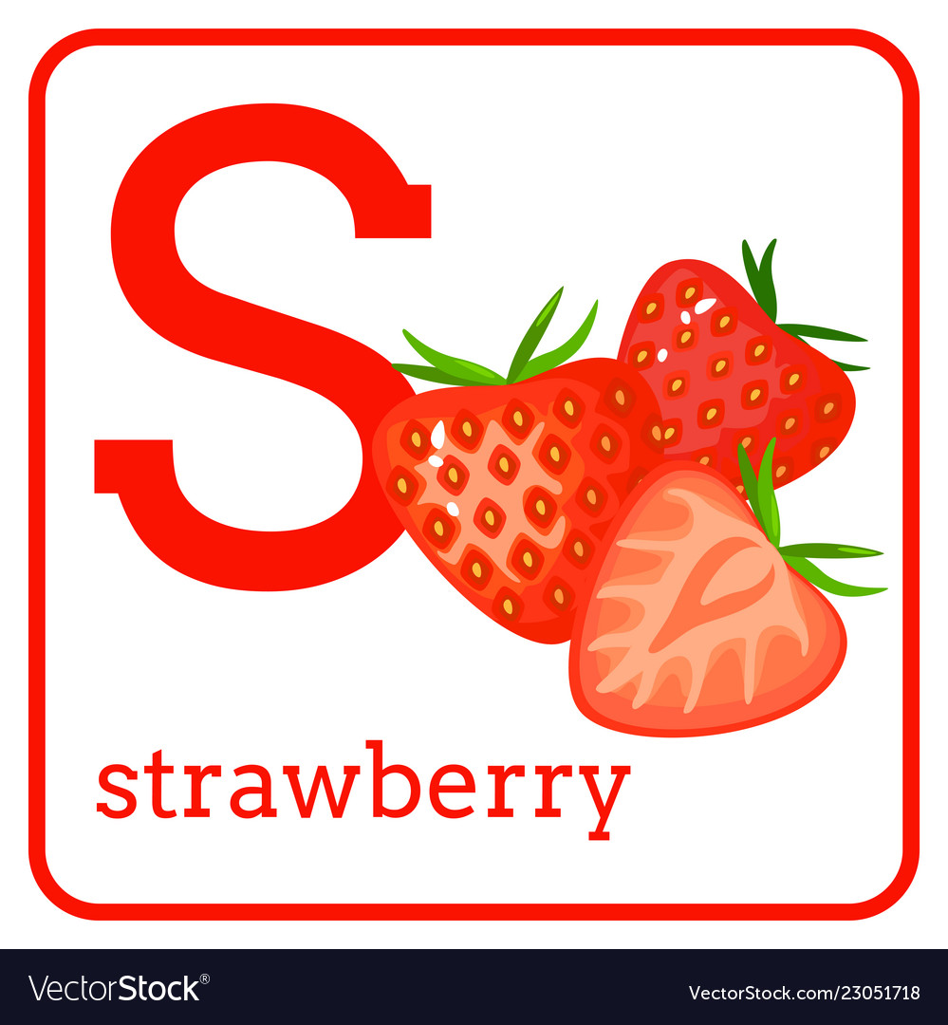
The theme for this week is the alphabet! Can you tackle all three tasks and complete the active alphabet adventure? Check out what's in each challenge this week!

Slide 4
In this week's personal best see how fast you can spell out your name using the exercises below! Take a look at the next page for more ideas on this activity!
= 5 star jumps
= 10 high knees
= 5 push ups
= 5 sit ups
= 5 burpees
= 10s plank
= 10s plank
= 5 burpees
= 10 toe touches
= 5 squats
= 5 tuck jumps
= 5 star jumps
= 5 lunges
= 10 high knees
= 10 punches
= 5 tuck jumps
= 5 push ups
= 5 sit ups
= 5 squats
= 5 lunges
= 5 sit ups
= 5 burpees
= 10 punches
= 5 tuck jumps
= 5 lunges
= 5 tuck jumps
Need help?
Here's a link to our example! https://youtu.be/OS1wWh2wHD8 & check out how to do the exercises properly here! https://www.youtube.com/watch?v=BlRzY6-5FWc

Slide 5
I can't do some of the exercises!
Here are some alternate ways/exercises to use if you can't do some of the other exercises!
Star Jumps/Tuck Jumps: sitting down move your arms up above your head & back down again.
Push Ups: sitting down at a table place your hands on the edge of the table and bring your chest forward & push away again.
Toe Touches: use toe taps on the floor instead or reach as low as you can towards the floor.
Plank: stretch and hold your arms out in front of you.
Lunges: change out lunges for bicep curls without/or with the weight.
Squats: change out for sitting tummy twist, hold your arms out in front of you and rotate your torso from side to side.
Burpees: switch out for overhead arm raises.
High Knees: change out for sitting shoulder retractions, sit down and hold both arms out in front of you, and then retract so your elbows are in line with your chest, then extend again.
I'm finding it quite hard!
If your middle name or surname is shorter then you could use one of them instead? Alternatively you could reduce the number of repetitions needed for each letter then work up to the full amount!
It's too easy for me!
If you're finding it easy to get through your first name why don't you add in your middle name and even your surname? If you want an even bigger challenge try and make it through the whole alphabet!

Slide 6
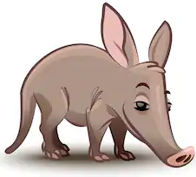
This week's virtual challenge is Animal Alphabet! For this challenge you will need three target "hoops", a ball, some paper and some great animal knowledge! Start by placing your target hoops down on the ground in a vertical line about two big steps apart. Next write down A, B & C on a separate pieces of paper (you can use small bits of paper for this) and put A down next to one hoop, B to the next hoop and C to the last hoop. Now take 5 big steps backwards and mark down a throw line (you can use anything for this!). Grab your ball and try to throw it into hoop A, B or C to get 5 points! If you land the ball in the hoop you then have 30 seconds to name as many animals beginning with that letter as you can, you get a bonus point for every animal you think of! Once you've done A, B & C why not keep working down the alphabet?
Mix it up!
You could try kicking the ball into the target instead to change this game up!
It's too easy!
Move your throwing line further back & try using different types of throws!
It's too hard!
Try moving your throwing line closer to the targets or make your targets a bit bigger!
No hoop or ball?
No ball = rolled up socks! If you haven't got any hoops you could make a circle out of toys!
Need help?
Here's a link to our example! https://www.youtube.com/watch?v=EOqkPOqJfoo
Get some practice at throwing with our top tips here: https://www.youtube.com/watch?v=FKLbaH7Oc-4

Slide 7
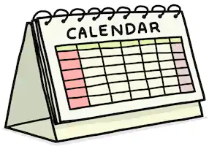
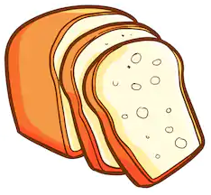
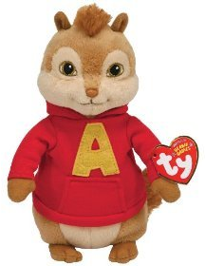
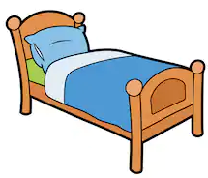
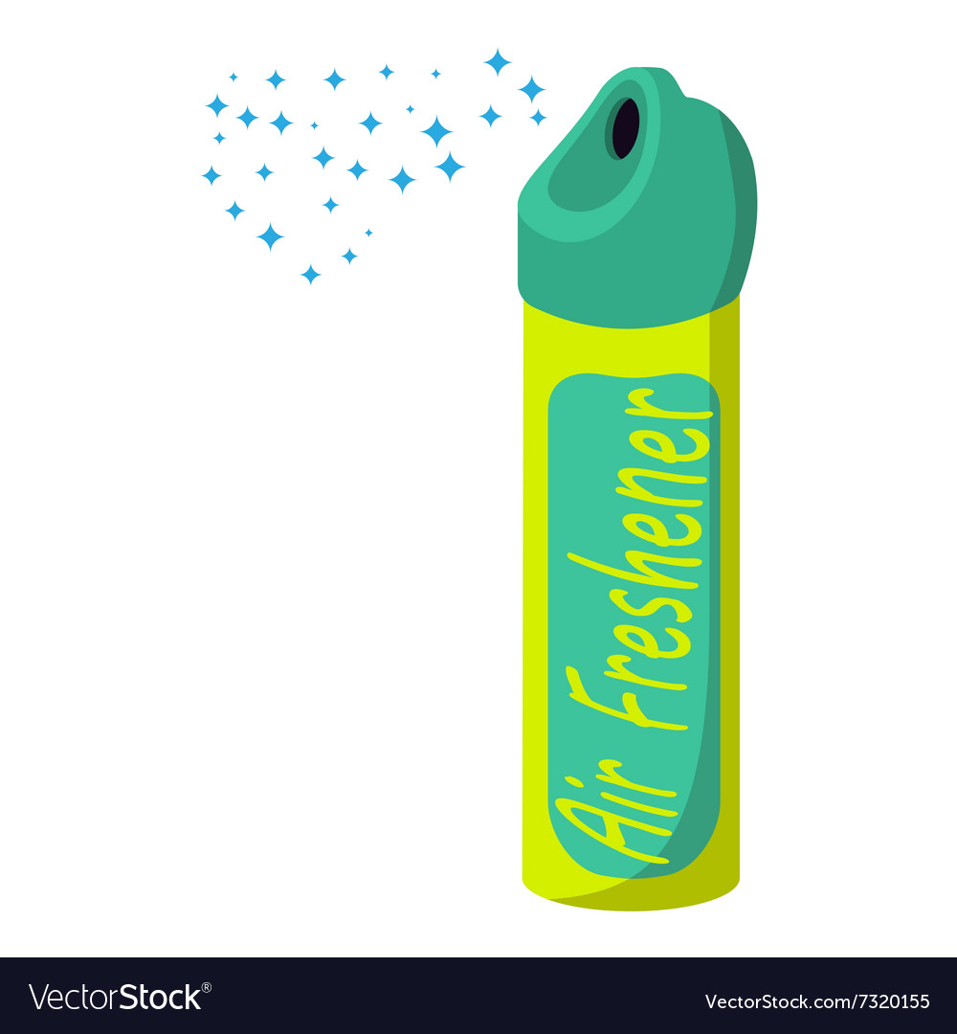
For this week's creative challenge you'll have to get your hunting hats on and get ready to begin the alphabet adventure around your own home! We want you to find as many objects in your home that begin with the same letter as your name as you can! If you're struggling with your name, why not use your school's name instead?
Need help?
Here's a link to our example! https://www.youtube.com/watch?v=A6K7mY3CAEg

Slide 8
Twitter
@NWLSSP
Facebook
@northwestleicestershiressp
Instagram
@NWLSSP

