Slide 1






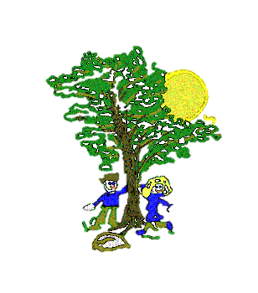







Art
In our Art lessons we will be:
Using materials creatively to create a sculpture
Manipulating clay in a variety of ways
Describing similarities and differences between different practices making links to our own work.
Computing
In Computing we will be:
Sorting information into categories using yes/no questions
Using a database to answer questions
Maths
In our Maths lessons we will be:
Making equal groups to add numbers
Introducing the multiplication symbol
Using arrays to solve multiplication sentences
Doubling and halving numbers
Using our times tables to divide by 2s,5s & 10s
Solving multiplication sentences
Science
In our Science lessons we will be:
Identifying different animal groups
Comparing different stages of human life-cycle
Describing the basic need for survival
Learning the effects of exercise on the human body
P.E.
In our PE lessons we will be:
Swimming once a week
Gymnastics:
Linking one or more movements together
Travelling by rolling forward, backwards and sideways.
Maple Curriculum Map
Spring 1
History
In our History lessons we will be:
Using Dawson’s model to identify significant people in history
Learning about Alice Hawkin, a suffragette who lived in Leicester
Learning about Emmeline Pankhurst and other suffragettes
R.E.
In R.E. we will be learning about:
Islam: Who is a Muslim and how do they live?
English
In our English lessons we will be:
Learning to write a story based on the book ‘The Lighthouse Keepers Lunch’
Learning to use speech in our writing
Using punctuation to enhance our writing
Editing and redrafting our work
Music
In our Music lessons we will be:
Looking at the difference between volume and pitch
Composing a short piece of pitched music
Performing and evaluating their piece of music
PSHE
In our PSHE lessons we will be focusing on:
Healthier and safer lifestyles: Drug Education

