Slide 1
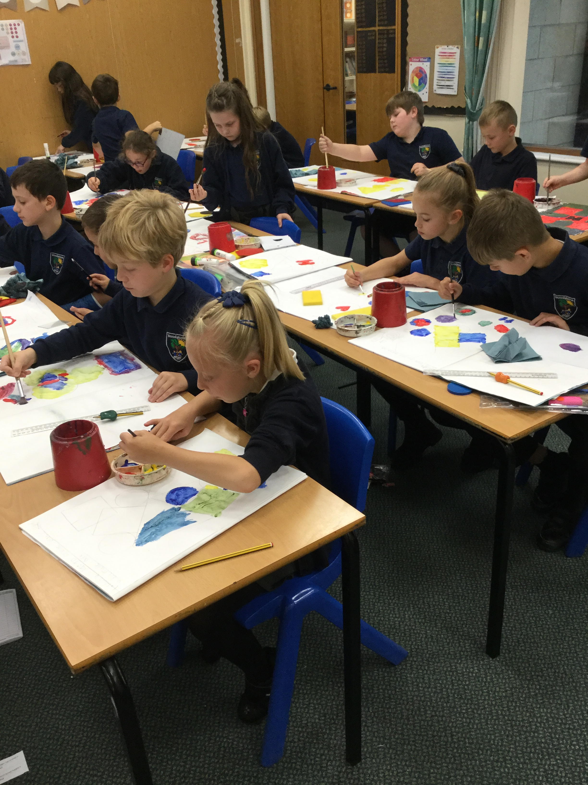
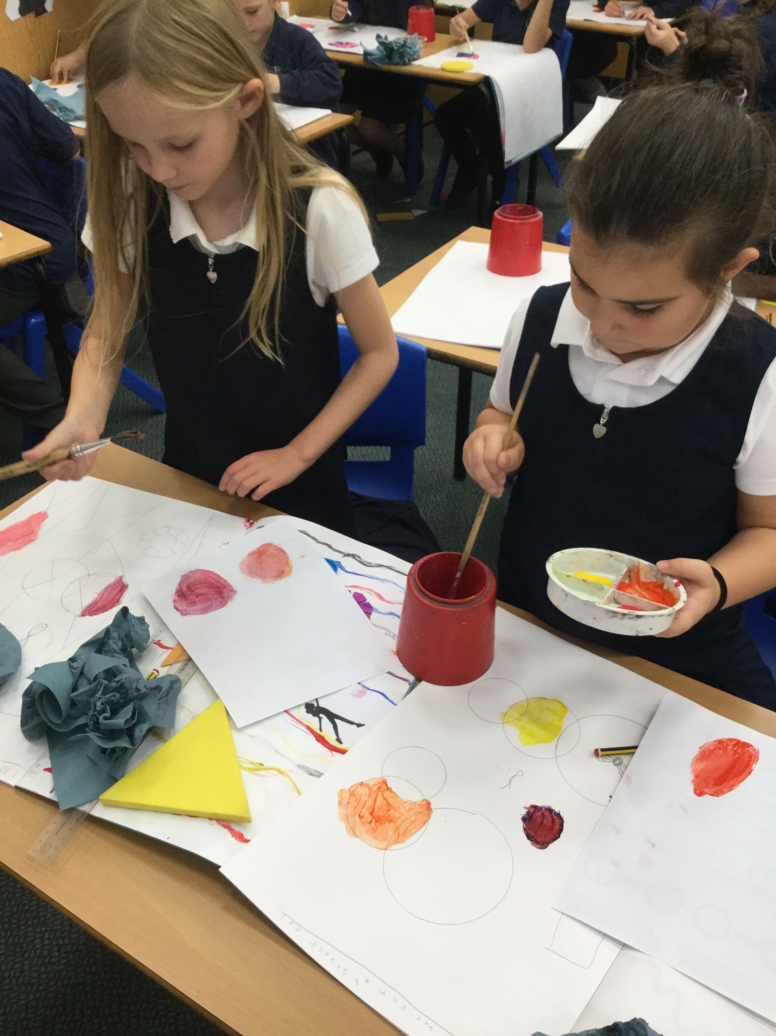
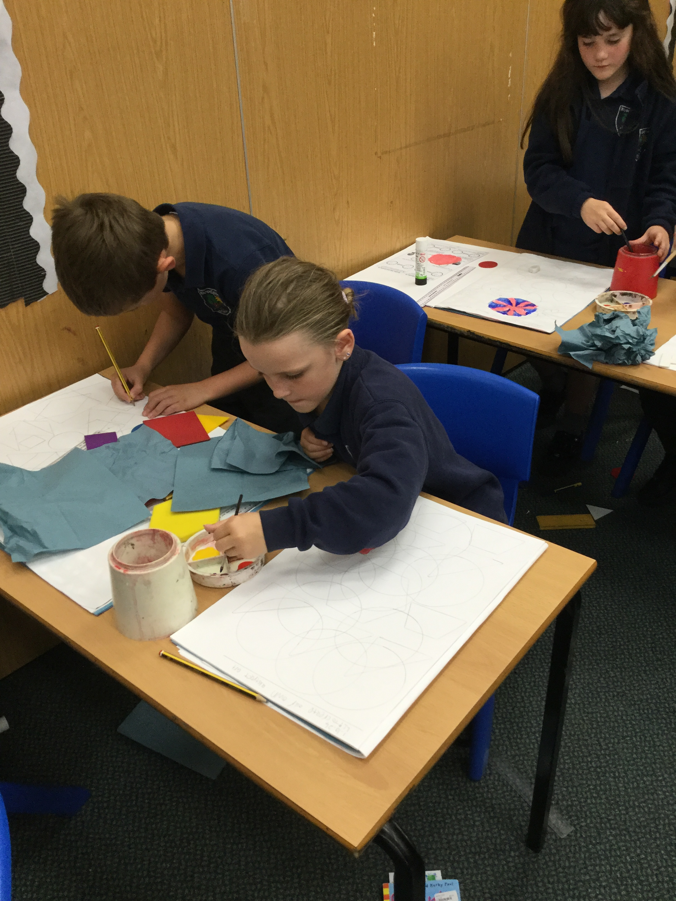
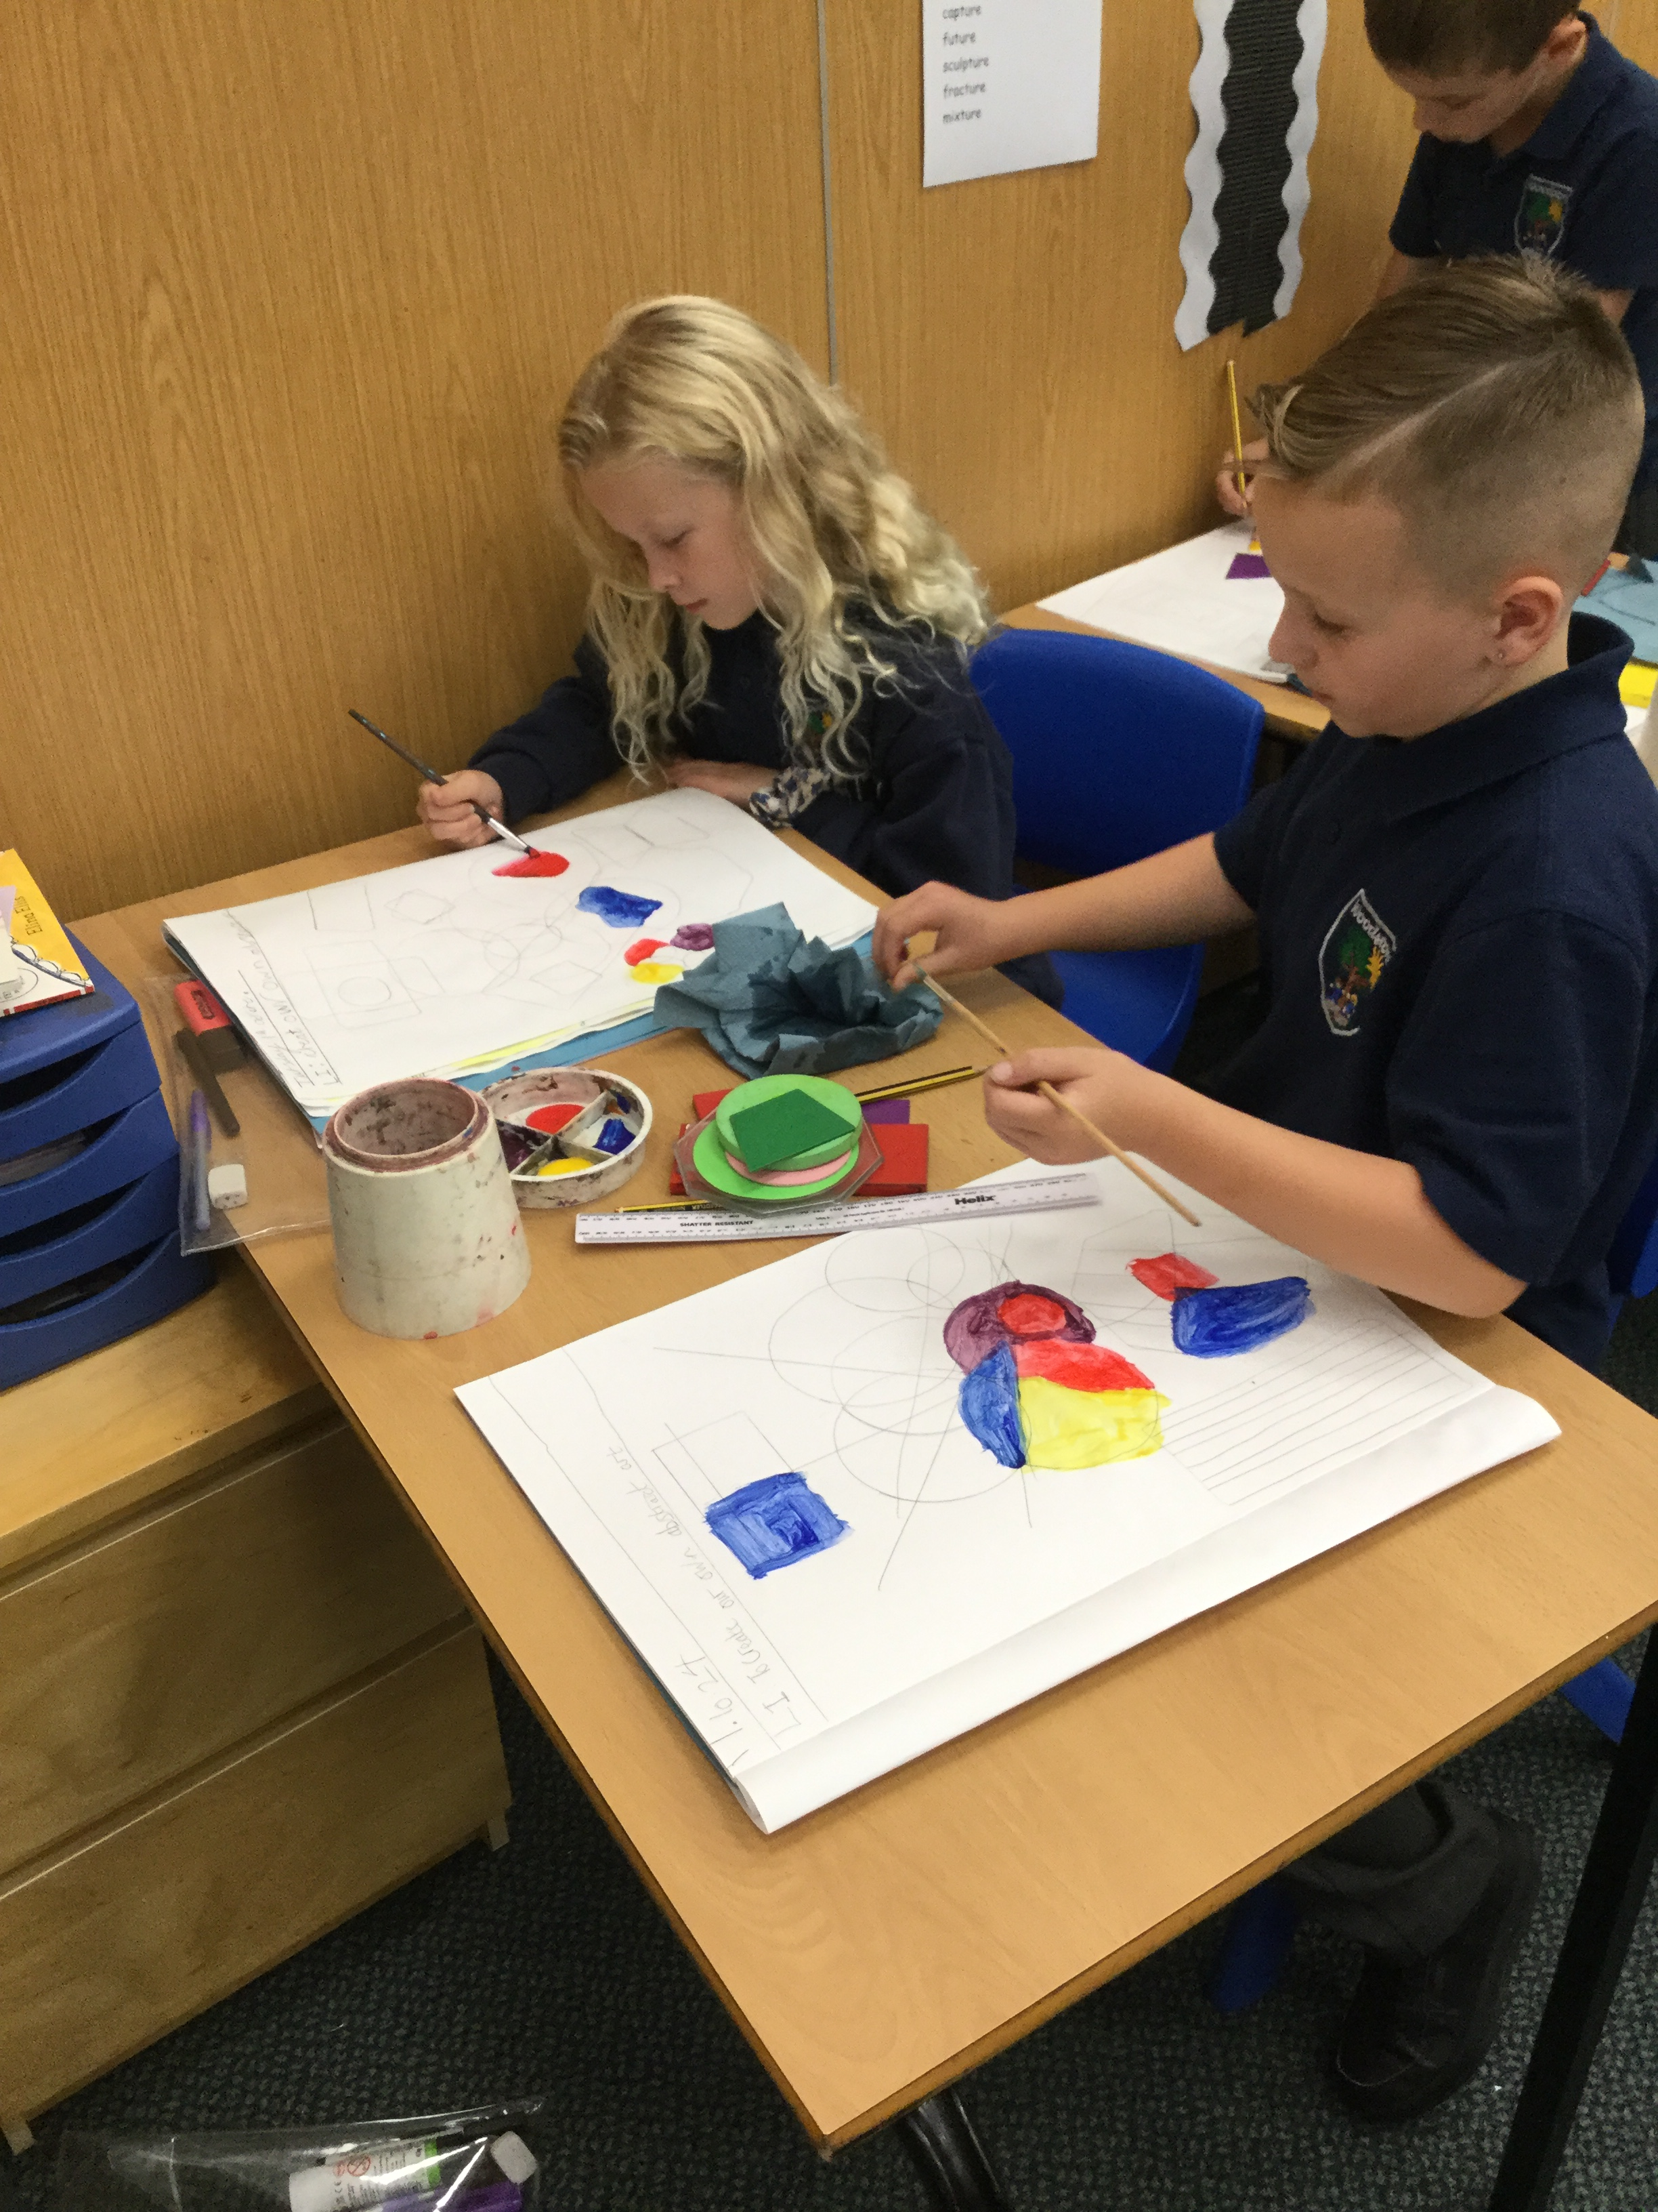
Art- Hilma Af Klint inspired piece
Today we had lots of fun experimenting with the different paint skills we have learnt over the last few week to create our own abstract pieces of art. We used the primary colours (red, blue and yellow) and black and white to create shades and tones to convey emotion, and incorporated different shapes too. Great work Year 3!

Slide 2
