Slide 1
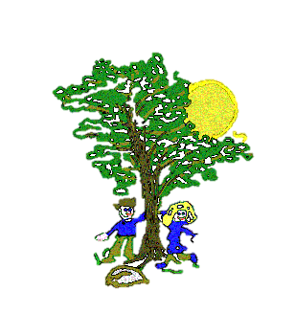
Art
This half term we will be creating our own sculptures of Ancient Egyptian canopic jars! This will link with our learning in history, as well as adding to our sculpting skills such as coiling and pinching clay to make our jars.
We will be doing our topic ‘Animals Including Humans’. We will learn about the nutrition we need as well as about skeletons and muscles and why we need them!
Maths
This half term we will be studying:
Length and perimeter
Fractions
Computing
This half term we will be learning how to use email safely and what branching databases are and how to develop their own.
Science
P.E.
This half term we will be doing basketball on a Tuesday afternoon and dance on a Thursday afternoon.
Year 3 Curriculum Map
Spring 2
History
This term our topic is ‘Ancient Egypt’. During our lessons we will learn about the chronology of events during this era, how the Egyptian people lived and what happened to them after they died.
R.E.
This term’s Judaism topic explores how festivals and family life show what matters to Jewish people.
English
Our first unit will be based on a poem called ‘Summer is here’. We will use this as inspiration to write our own poems about Spring.
We will then move on to the book ‘The Incredible Book Eating Boy’ by Oliver Jeffers. Each lesson we will work through the different parts of the book, adapting it using our own vocabulary choices. Once finished, we will have the opportunity to write our own comedy narrative!
Music
This term our topic is ‘Pitch’. Children will learn about using pitch to create different moods and emotional responses and will use some of the music they have heard as inspiration to create their own work.
PSHE/French
PSHE – Healthy and safer lifestyles – managing safety and risk, in particular digital risks.
French – Family and friends.

