Slide 1
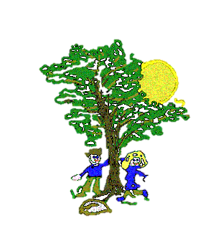
Art/D&T
We will learn to print and use basic sewing stitches to make small bags.
Computing
We will learn about effective searching as well as continuing to develop our on-line safety awareness.
Maths
We will learn about:
decimals; money; time; geometry. We will also complete our Multiplication Test.
Science
We will learn about food chains.
P.E.
We will develop our running, throwing and jumping skills in athletics and our net and wall games skills in tennis.
Cedar Curriculum Map
Summer 2
Geography
We will learn about Rainforests including where they are located, their climate and who lives there.
R.E.
We will focus our learning on what is right and what is wrong.
English
We will develop our English skills through: writing an explanation; reading and answering questions on different genre texts; learning new spelling words and rules.
Music
We will continue to develop our musical skills through singing a range of songs and playing the ukulele.
French
In French we will learn about holidays and hobbies and have a French morning to practise our skills.

