Slide 1



Slide 2



Welcome!
Year Name:
Rowan
Teacher:
Mrs Stanley
TA:
Miss Tyrer

Slide 3
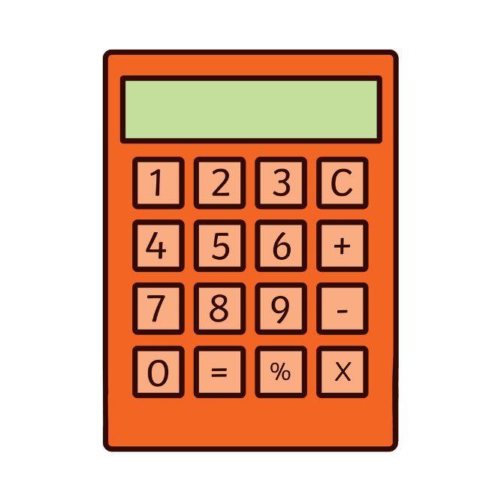
A bit about me
I joined Woodstone in January 2025 after relocating from Manchester.
Last year I taught in Year 1 and the year before in Year 2.
I have been a teacher for the last 8 years.
Over that time I have taught Year 2 for 2 years and Year 1 for 6 years.

Slide 4
A bit about Miss Tyrer
I joined Woodstone August 2025 after relocating from Abu Dhabi.
I have worked in education for nearly 30 years.
I have worked with all age groups from nursery through to A-level child care and education.
The last 9 years have been predominantly across EYFS and KS1.

Slide 5
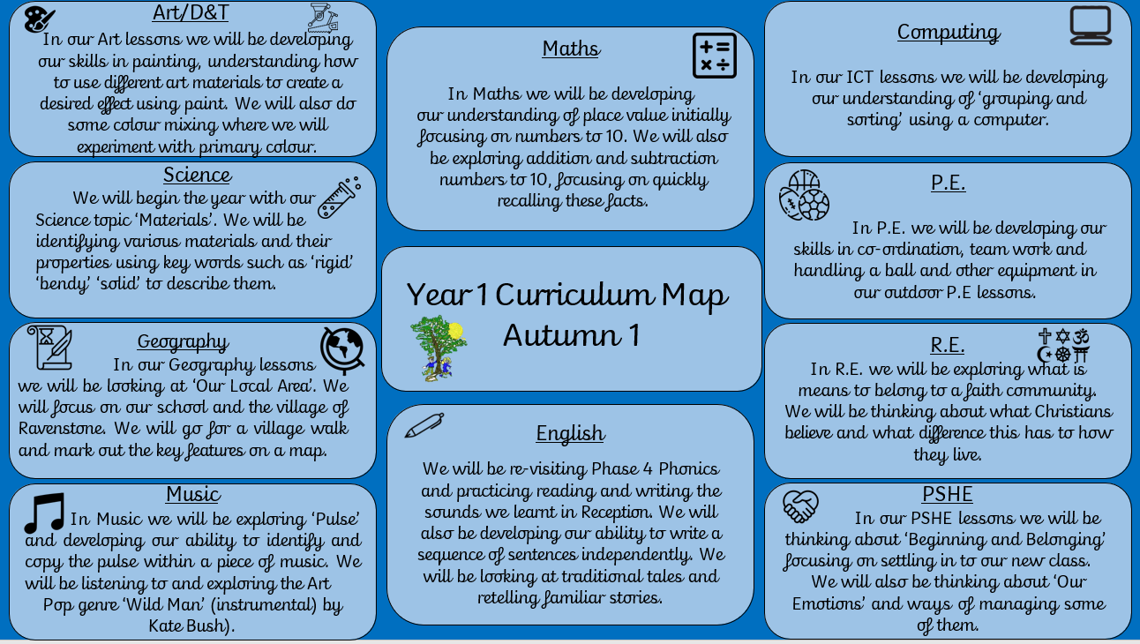
We are learning

Slide 6
Classroom Rewards
Class Dojo’s
Stickers
Name System

Slide 7

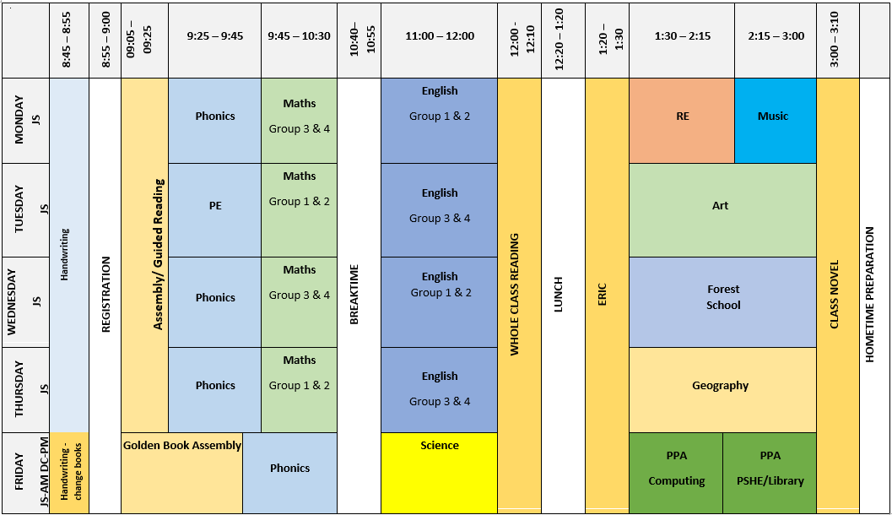
Class Schedule

Slide 8
PE
We have PE every Tuesday this half term.
Please ensure you child has trainers as we will be going outside as much as possible this half term.
As the days get colder please ensure you child has appropriate clothes i.e. jumpers/joggers.
Please ensure that their PE kit is in school so we can do each lesson safely.
Please make sure it all fits, especially shoes… we’ll do our best to let you know when they say ‘My plimsolls are too small’!
Try to take earrings out before they come to school on PE days.
Please label their PE kit, this really helps us when getting changed.

Slide 9
Forest School
Our Forest School sessions are on Wednesday afternoons this half term. Please ensure you child has the following, all labelled:
Wellies
Thick socks
Long sleeve trousers
Long sleeve top
Waterproofs
Hats
Gloves
We will be starting our sessions on Wednesday 9th September for 5 weeks.
* Volunteers needed!

Slide 10
Phonics Screening Check
This is a national test that takes place in June for Year 1 children.
The test contains 40 words. Each child will sit one-to-one and read each word aloud to a teacher. The test will take approximately 10 minutes per child, although all children are different and will complete the check at their own pace. The list of words the children read is a combination of 20 real words and 20 pseudo words (nonsense words).

Slide 11
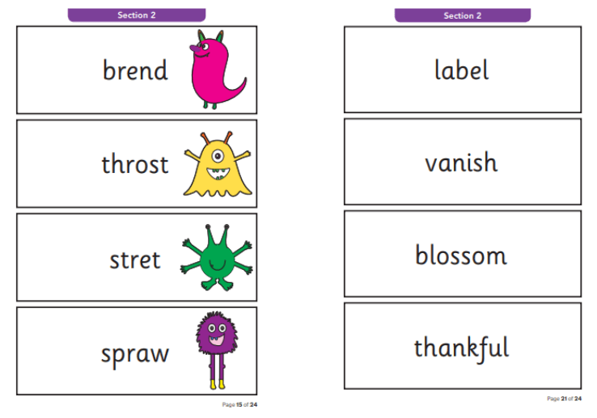

Slide 12
Homework
Your child will receive a piece of Maths homework every Friday. Please return the homework by the following Wednesday.
Reading has a huge impact on children’s development therefore we ask for parents to read with their children at least five times per week in order for them to reap the full benefits. Children will receive a sticker and be entered into our weekly reading raffle for reading 5 times (for around 10 minutes) per week.
Likewise, it is very important that children are read to as this helps develop their understanding of texts, expand their vocabulary and teaches them how to read with expression.

Slide 13
Enrichment
Harvest Festival 29th September
Nativity
TBC
Swimming Spring 2
Tamworth Castle
Spring 2
Visit to Attenborough Arboretum
Spring 2

Slide 14

Milk
In Year 1 we are unable to give milk to those who are not on the list due to health and safety reasons.
If you would like your child to have milk please let the office know.
We have some children not wanting their milk, if you no longer want your child to have milk just let the office know.

Slide 15
Outdoor Area
We have recently developed our outdoor area but with tight budgets we would greatly appreciate any donations!
We are looking for:
Soil
Plants/flowers
Overalls/ puddles suits
Play-doh cutters/rolling pins
Home corner toys

Slide 16
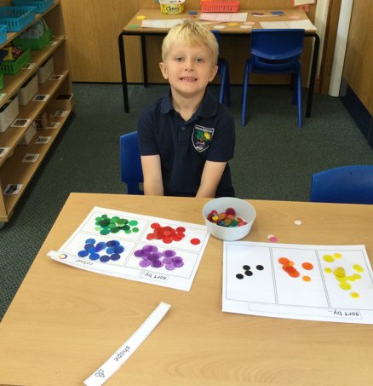
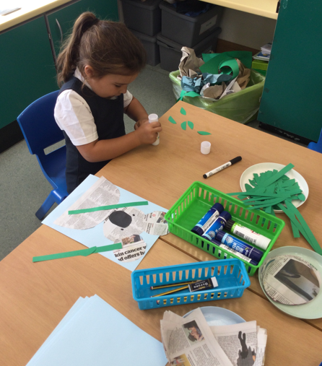
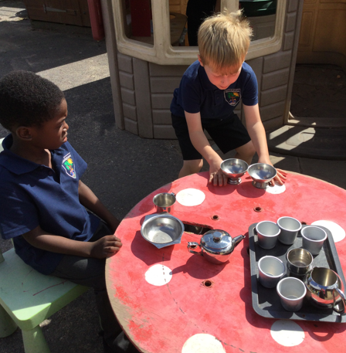
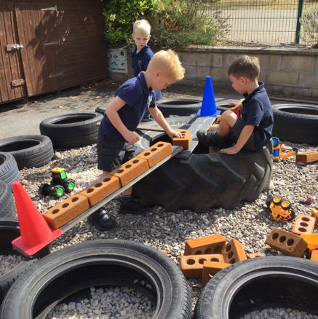
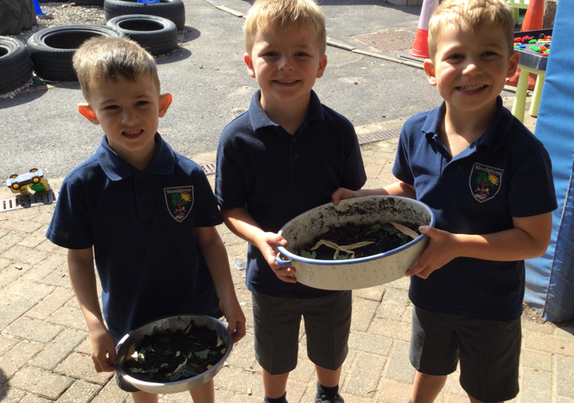
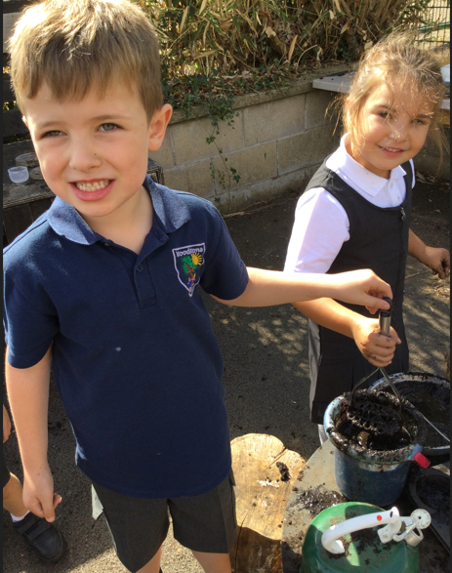

Slide 17
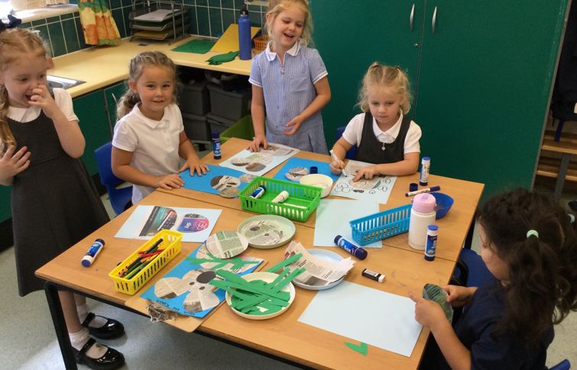
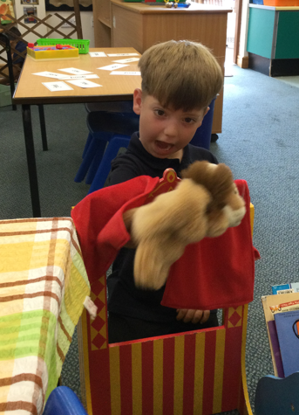
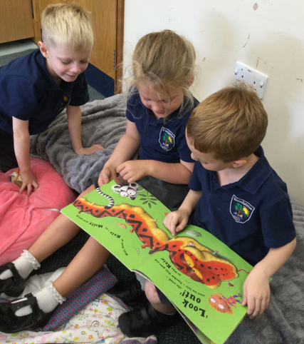
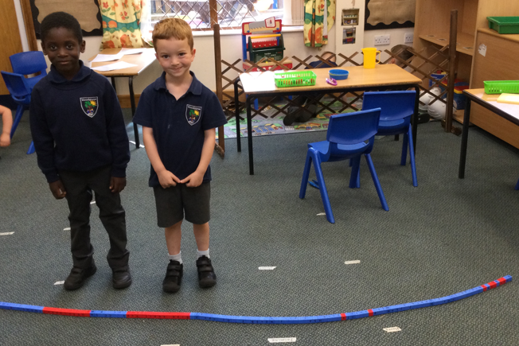

Slide 18
As always, I am always at the gate in the morning and afternoons if there is anything you need or any questions you have.
You can also contact me on Year1@woodstone.leics.sch.uk

