Slide 1
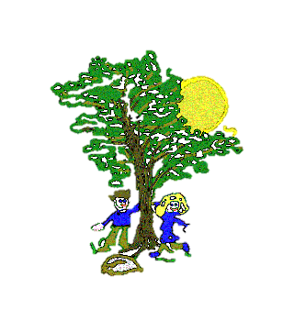
Art
In our Art Lessons we will be:
Learning about Roy Litchtenstein, an American pop artist.
Using the ‘Ben-day dot’ technique to build colour and texture
Experimenting with water colours
Computing
In our Computing lessons we will be:
Learning to understand and use algorithms
Creating programs using different actions
Learning how to debug simple programs
Maths
In our Maths lessons we will be:
Counting, comparing, ordering and representing numbers to 100
Counting in multiples of 2s, 3s, 5s and 10s
Using a place value chart to identify tens and ones
Recognising, describing and comparing 2D and 3D shapes
Science
In our Science Lessons we will be:
Identifying electrical appliances
Notice and describe how things move, using simple comparisons such as faster and slower
P.E.
In our PE Lessons we will be:
Practising our ball skills: throwing, catching and bouncing
Developing our hand-eye coordination and spatial awareness
Year 2 Curriculum Map
Autumn 1
History
In our History lessons, we will be:
Learning about a significant event beyond living memory: ‘The Great Fire of London’
Learning how to order events and key dates on a timeline.
RE
In our RE lessons we will be:
Learning about the religion of Islam
Exploring who Muslims are and what they believe.
English
In our English lessons we will be:
Learning to write an adventure story based on the book ‘The Owl Who was Afraid of the Dark’.
Learning to identify and sort adjectives and nouns.
Learning to use expanded noun phrases in our writing.
Music
In our Music lessons we will be:
Learning about pulse
Learning to play some simple notes a recorder
Listening to funk music by James Brown.
PSHE
In our PSHE lessons we will be focussing on:
Citizenship - Rights, Rules & Responsibilities
Myself and My Relationships – Family and Friends

