Slide 1






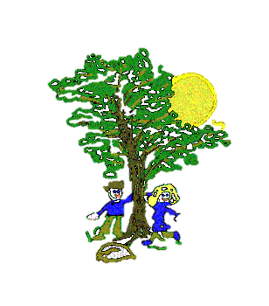







Art
In our Art lessons we will be:
Blending colours and creating contrasting tones
Creating a scene for a hot or cold place
Creating a collage of animals
Computing
In Computing we will be:
Creating and organising digital content
Recognising common uses of technology
Using technology safely and respectfully
Maths
In our Maths lessons we will be:
Telling the time past and to the hour
Creating and reading pictograms
Creating bar and tally charts
Understanding position and direction using the terms; right, left, clock-wise and anti-clockwise
Science
In our Science lessons we will be:
Identifying what plants need to grow
Learning the life cycle of a plant
Conducting an experiment to see how plants grow under a variety of conditions
P.E.
In our PE lessons we will be:
Learning and playing rounders
Developing a variety of athletic skills
Building on our team skills
Maple Curriculum Map
Summer 2
Geography
In our Geography lessons we will be:
Identifying and comparing hot and cold places
Identifying and understanding the equator
Identify the 7 continents and 5 oceans
Understanding the different weather conditions across the world
R.E.
In R.E. we will be learning about:
Places of worship
English
In our English lessons we will be:
Exploring tales
Gathering ideas for our own tale
Reading and adapting ‘A Crow’s Tale’
Writing, editing and redrafting a tale
Music
In our Music lessons we will be:
Identifying and performing a piece of film music
Identifying and performing a piece of The Beatles’ music
Creating and practicing a piece of music
PSHE
In our PSHE lessons we will be focusing on:
Managing Change

