Slide 1
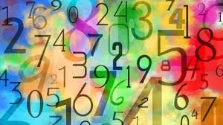
Daily Learning Tasks
26.06.2020
Maths
Basic Skills Test
As part of our maths lessons,
we complete ‘Key Skills Tests’.
The children should be very familiar with these.
Please see slides 2 and 3 for the test and answers.
Keep a track of your weekly score to see if you are improving. Ask an adult to go through a couple of errors with you so you understand where you went wrong.
English
Reading Comprehension
To end the week, we will be completing a reading comprehension.
Follow the link to access the learning:
https://www.bbc.co.uk/bitesize/articles/zqqxdp3
Join in with the activities provided and remember to pause when asked.
Geography
Rivers
Follow the link to access the BBC bitesize learning:
https://www.bbc.co.uk/bitesize/articles/z2kdbqt
Spelling:
Copy the following words to practice handwriting, then put the words into a sentence.
Spelling pattern – (short vowel past tense)
happened, rubbed, tapped, jogged, stopped, tripped
Can you think of more words that use this rule?

