Slide 1

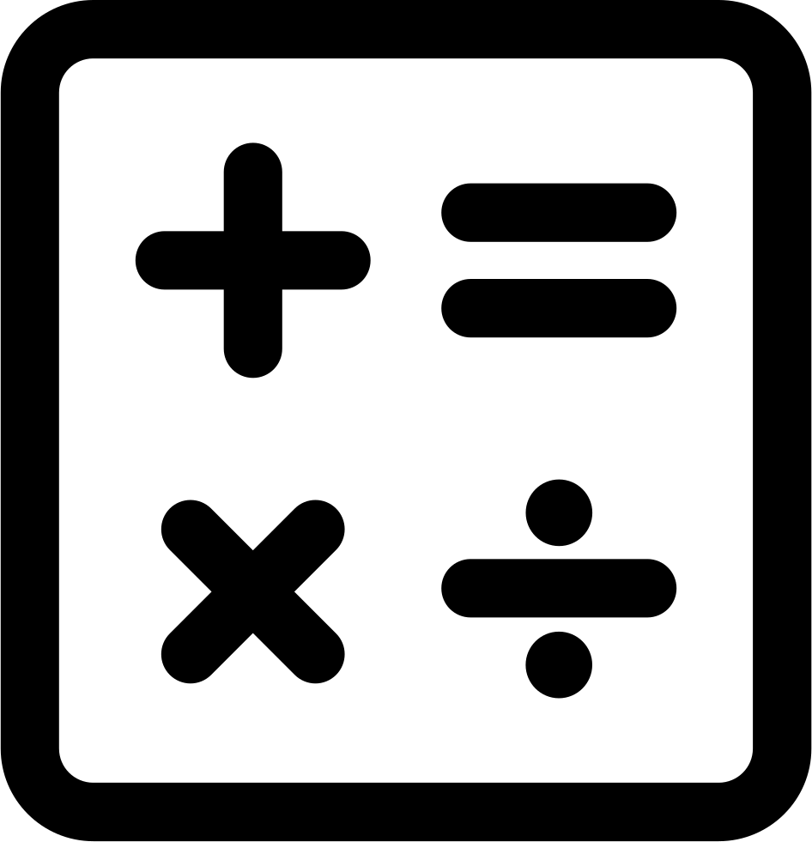




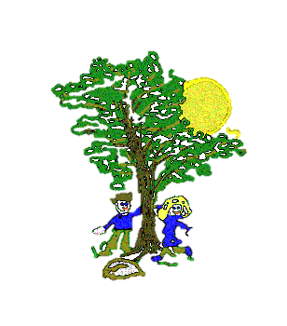







Art & DT
In our Art & DT Lessons we will be:
Learning about Anni Albers, a German textile artist
Using weaving to create a pattern
Learning how to plait
Maths
In our Maths lessons we will be:
Using our number bonds to 10 to identify number bonds to 20 and 100.
Identifying fact families using addition and subtraction number sentences
Adding and subtracting one and two-digit numbers across 10
Counting money and comparing amounts in pounds and pence
Making a pound and finding change
Computing
In our Computing lessons we will be:
Learning to use simple spreadsheets
Copying, cutting and pasting totals to add amounts
Science
In our Science Lessons we will be:
Identifying materials and describing their properties
Exploring how some objects made from different materials can be changed.
P.E.
In our PE Lessons we will be focusing on:
Developing our stamina, co-ordination, balance and flexibility in our Fitness lessons
Learning some simple Team Games involving throwing and catching
Year 2 Curriculum Map
Autumn 2
Geography
In our Geography lessons, we will be:
Identifying key human and physical features of a location
Learning how to use a compass
Devising and following simple maps
RE
In our RE lessons we will be learning about:
Christianity: Why Christmas is important to Christians.
English
In our English lessons we will be:
Learning to write a persuasive letter based on the book ‘The Day the Crayons Quit’
Learning to use commas within a list
Writing and punctuating questions correctly
Editing and improving our work
Music
In our Music lessons we will be:
Learning about voice
Learning to play notes ‘B’, ‘A’ and ‘G’ on the recorder
Listening to ‘I got you’, funk music
PSHE
In our PSHE lessons we will be focusing on:
Relationships: Family, Friends and Anti-bullying

