Slide 1

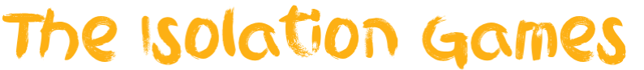

presents

Slide 2
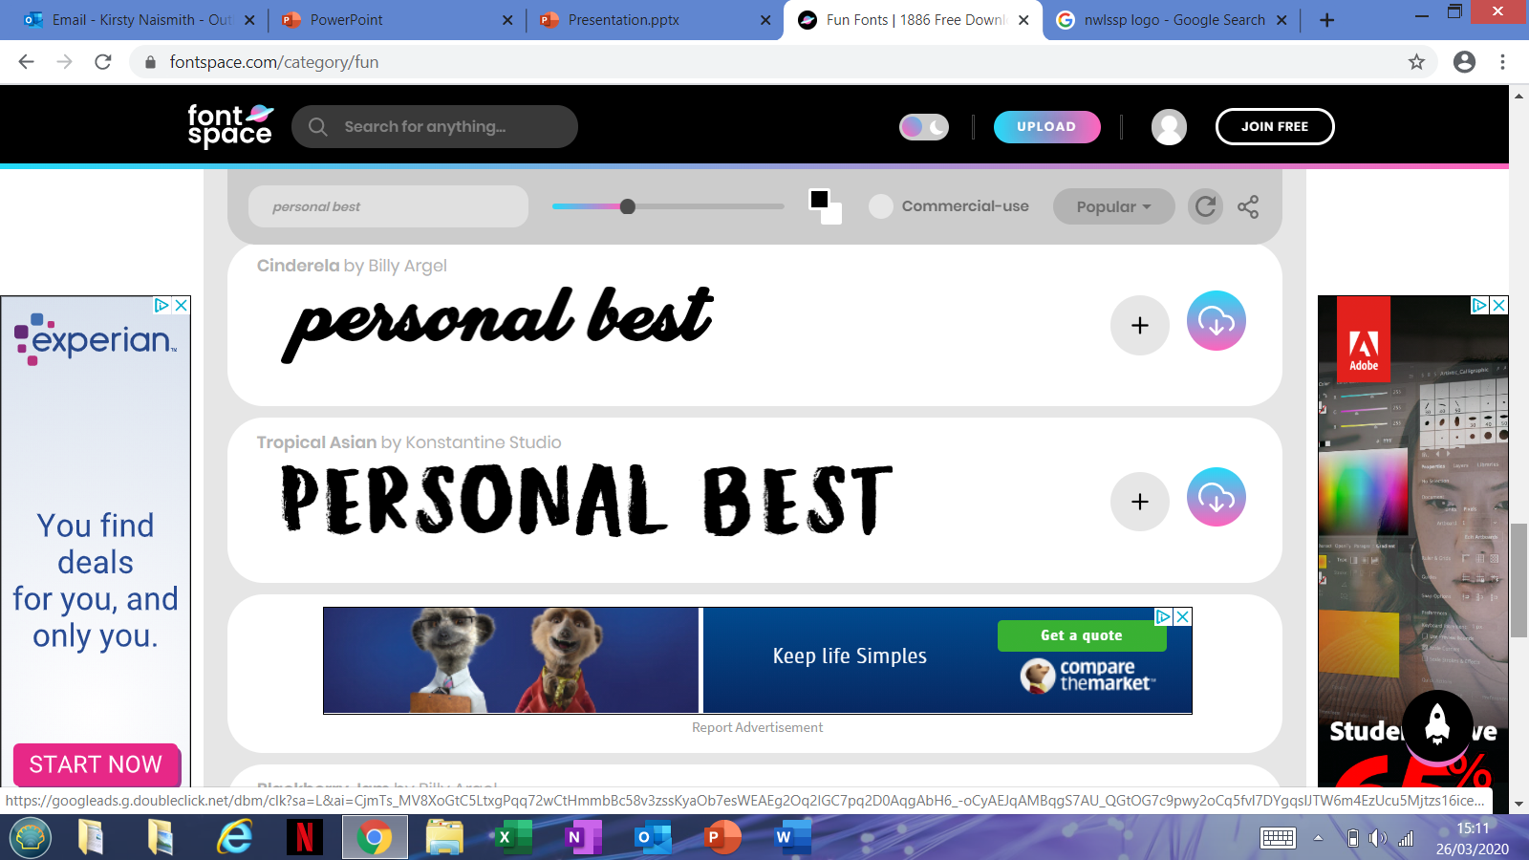
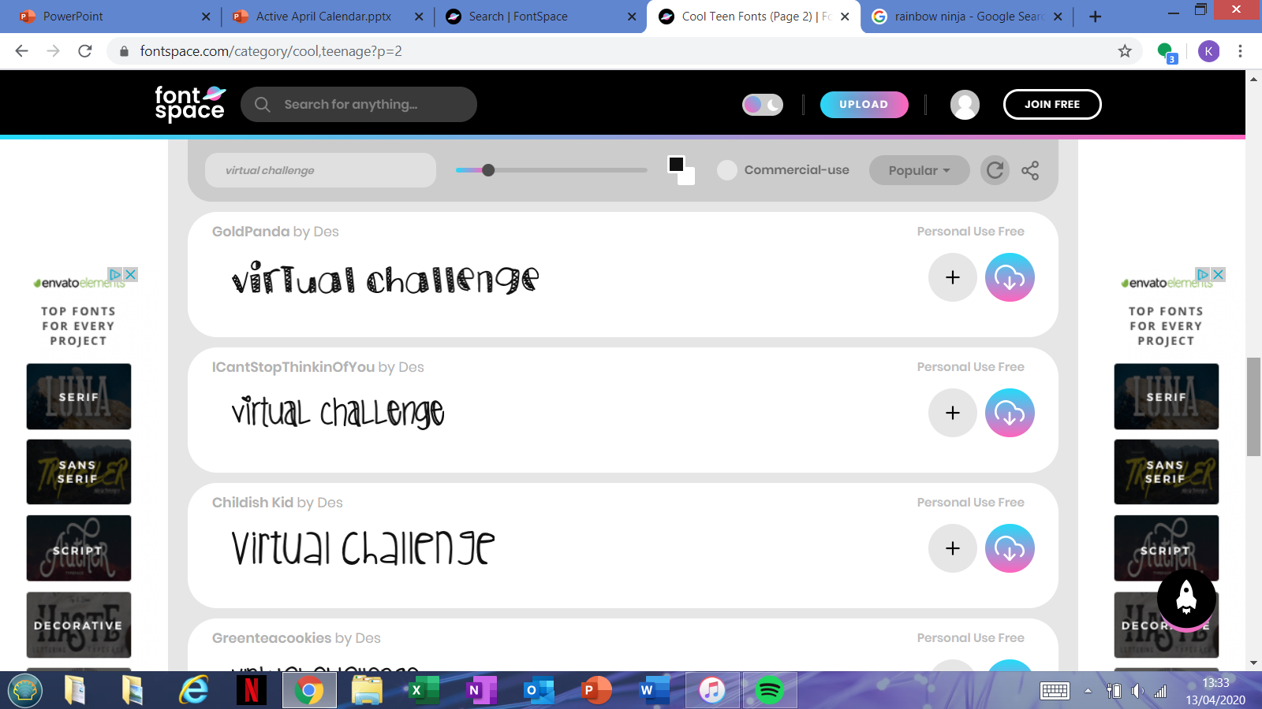
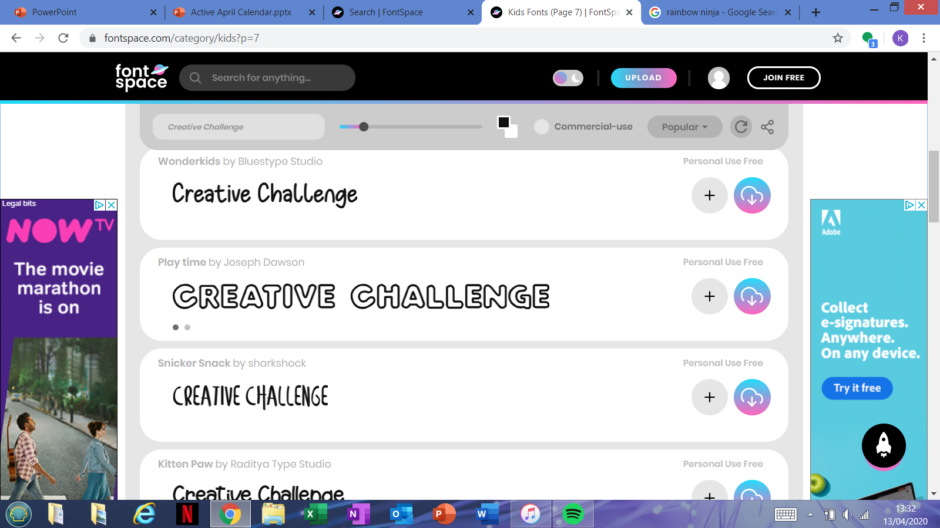
Challenge Types
These tasks are all about trying to beat your high score and be the best you can be! Don't worry if it's hard at first, practice makes perfect!
These competitions are ones you can take part in to help your school climb up the scoreboard, so give it your all in this huge team effort! It's all about participation!
These challenges will require you to get your problem-solving hat on and show us some of your creative ways to get active, remember to think outside the box!
Notes:
Hit targets of daily programme of activities, provide daily inspiration & hit objectives of teaching not just physical fitness but physical literacy, problem solving and personal challenges. Social aspect via online displays instead of classroom displays. Challenges to be developed from existing content + own variations, be promoted using the key hashtags etc.

Slide 3
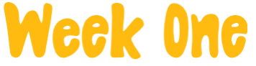

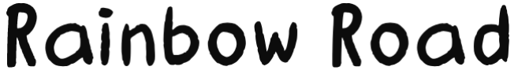
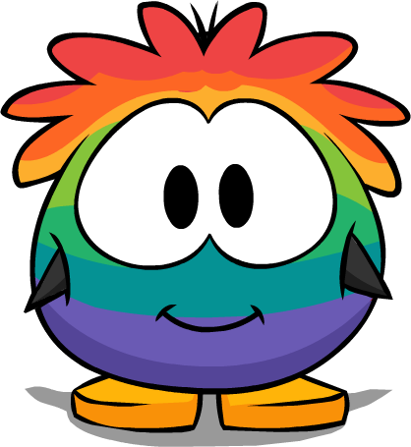
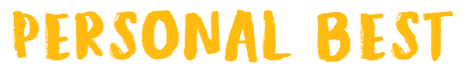
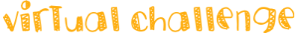
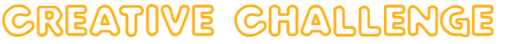
This week's theme is Rainbow Road! Can you go for all 3 challenges & complete the Rainbow Road? Take a look at what each challenge has in store for you!

Slide 4
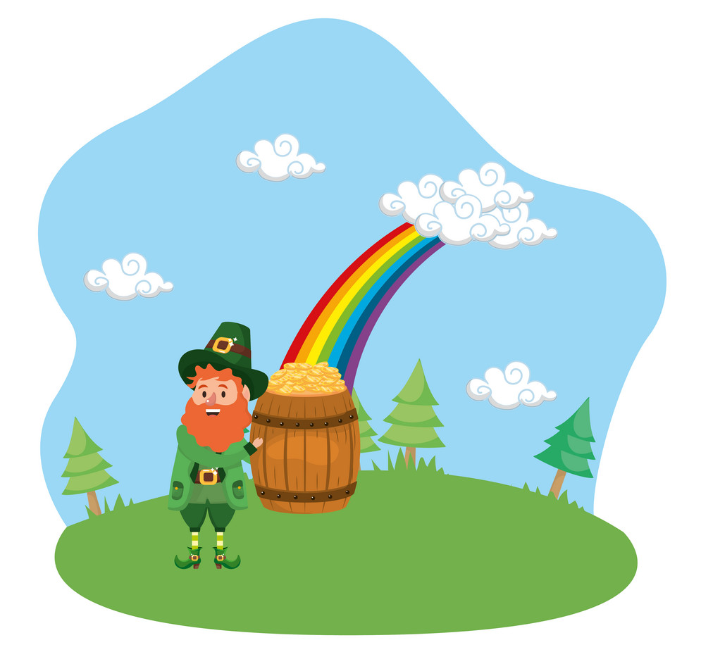

This week's personal best is to see how fast you can get through the rainbow fitness test and climb the rainbow ladder! Take a look below!
Green: 10 Toe Touches!
Yellow: 10 Lunges!
Blue: 10 High Knees!
Rainbow Ladder:
3+ minutes: Rainbow beginner
2:30 - 3 minutes: Rainbow Leprechaun
2 – 2:30 minutes: Rainbow Elf
1:30 - 2 minutes: Rainbow Wizard!
1 – 1:30 minutes: Rainbow Ninja!
Under 1 minute: Rainbow Warrior!
Orange: 10 Sit Ups!
Indigo: 10 Tuck Jumps!
Red: 10 Star Jumps!
Violet: 10 Punches!
Need help?
Here's a link to our example! https://www.youtube.com/watch?v=THERWO0x590

Slide 5


This week's virtual challenge is the rainbow target throw! For this challenge colour in (or label) 7 different pieces of paper, one red, orange, yellow, green, blue, indigo & violet! Then stick the paper to the wall with red starting the lowest & violet being the highest on the wall. Take 4 big steps back and mark out a throwing line (you can use anything for this!) and grab a soft ball. Now see if you can hit all the colours in order without missing a target!
No paper or ball?
If you haven't got a ball you can use a rolled up pair of socks instead! If you haven't got any paper you could use different coloured objects and place them on the floor instead of the wall.
Mix it up!
How many ways can you find to throw the ball? Under arm, over arm, maybe even throwing it behind you or between your legs?
It's too easy!
See how fast you can hit all the targets without missing one! Try moving your throwing line further back!
It's too hard!
Try moving your throwing line closer to the targets, or move the targets lower down the wall!
Need help?
Here's a link to our examples! https://www.youtube.com/watch?v=_5ZMF18ksnA

Slide 6
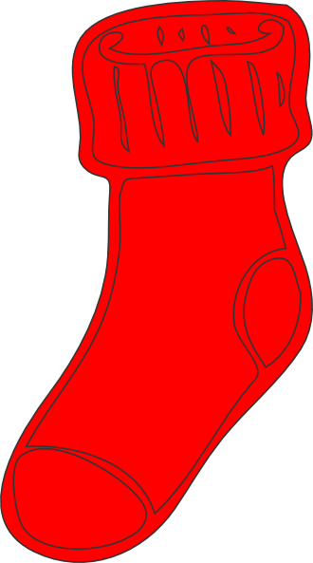
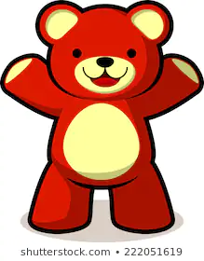
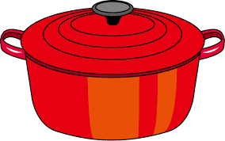



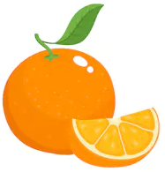
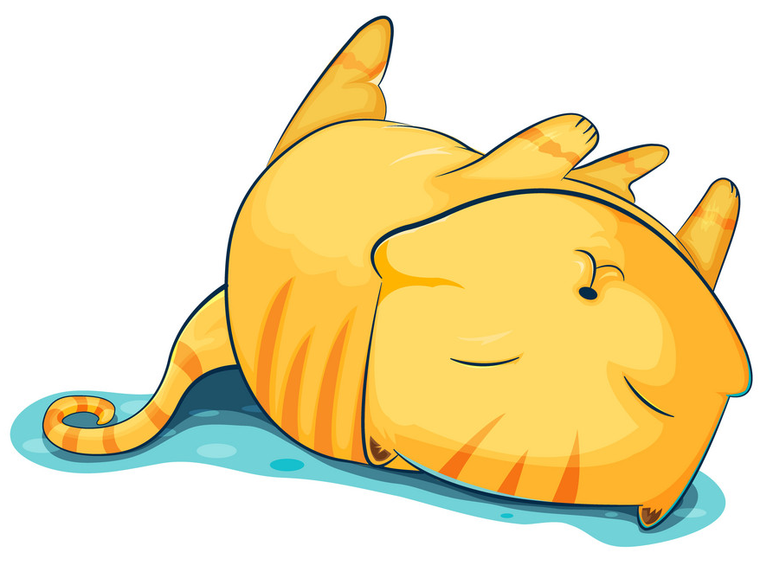
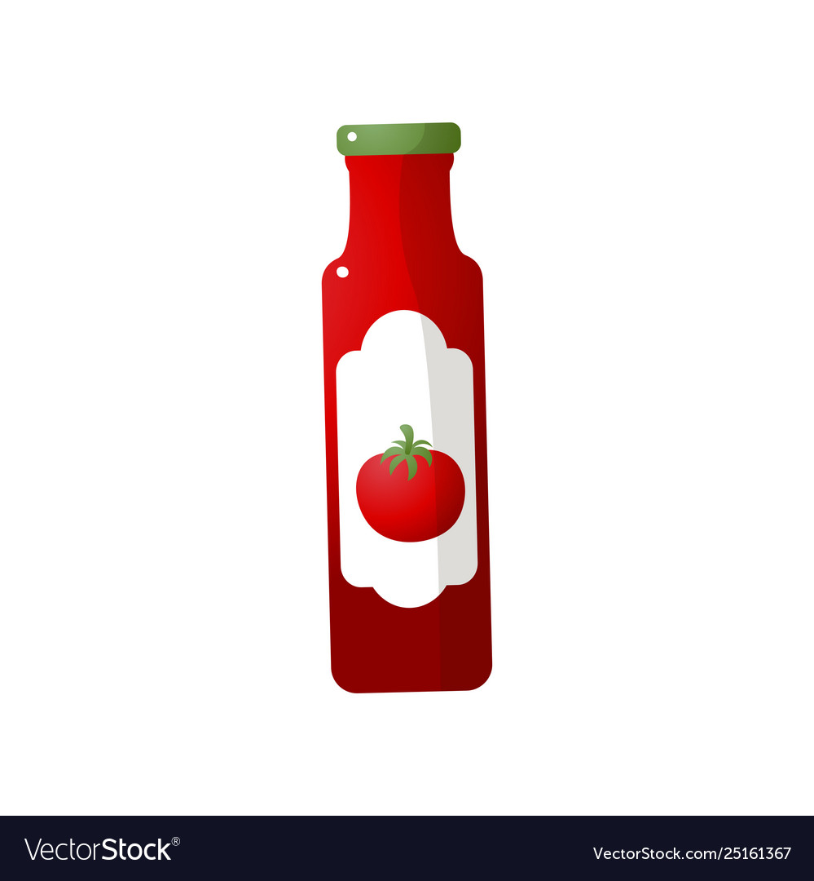
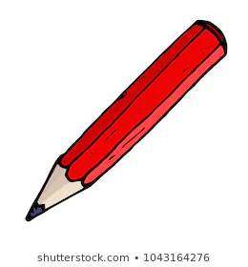




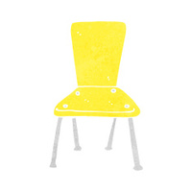

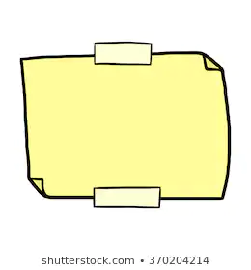
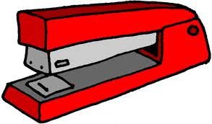


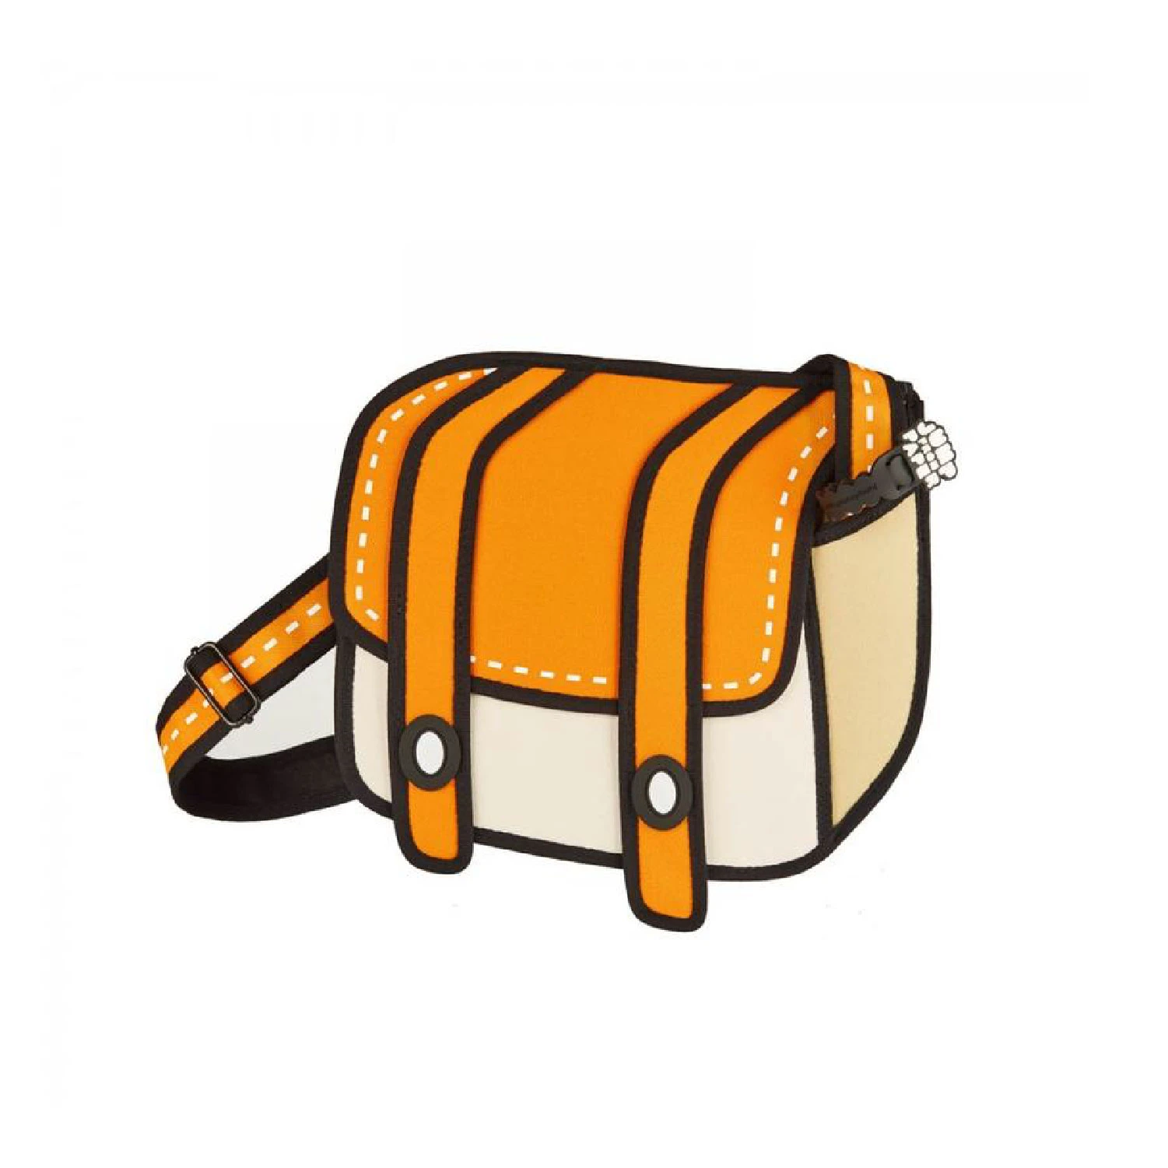

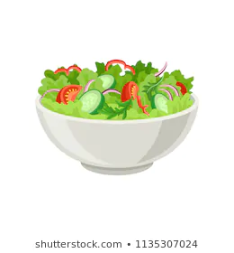

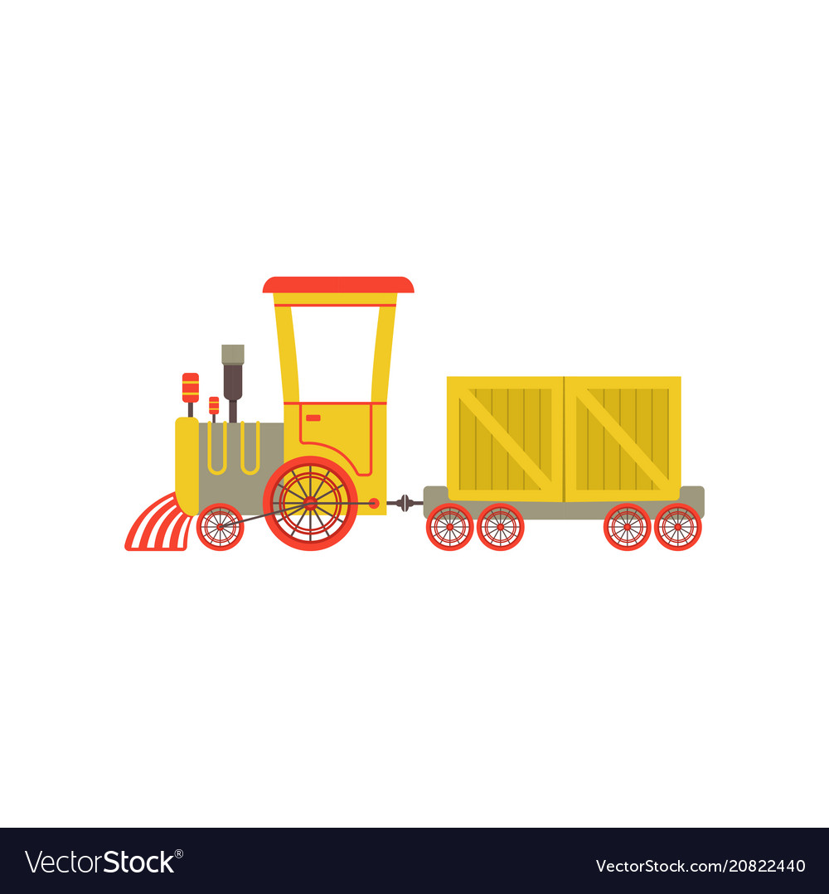
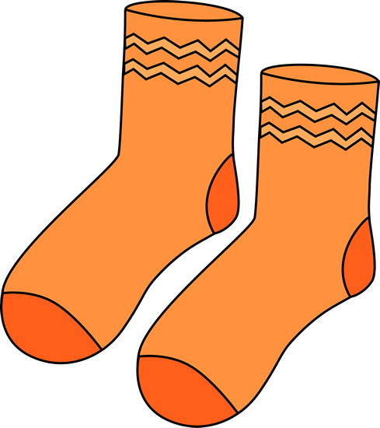





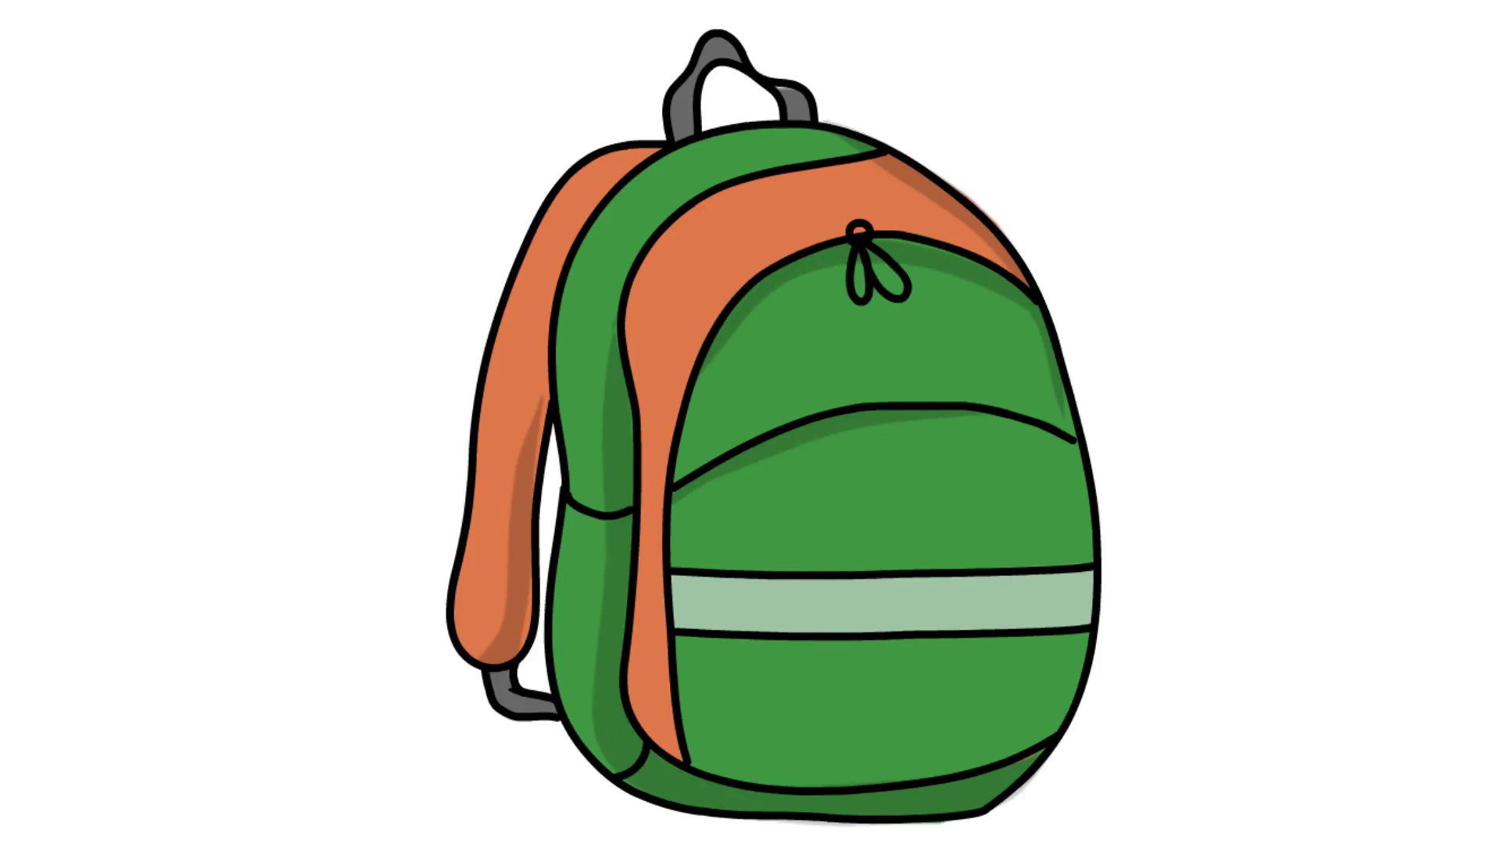
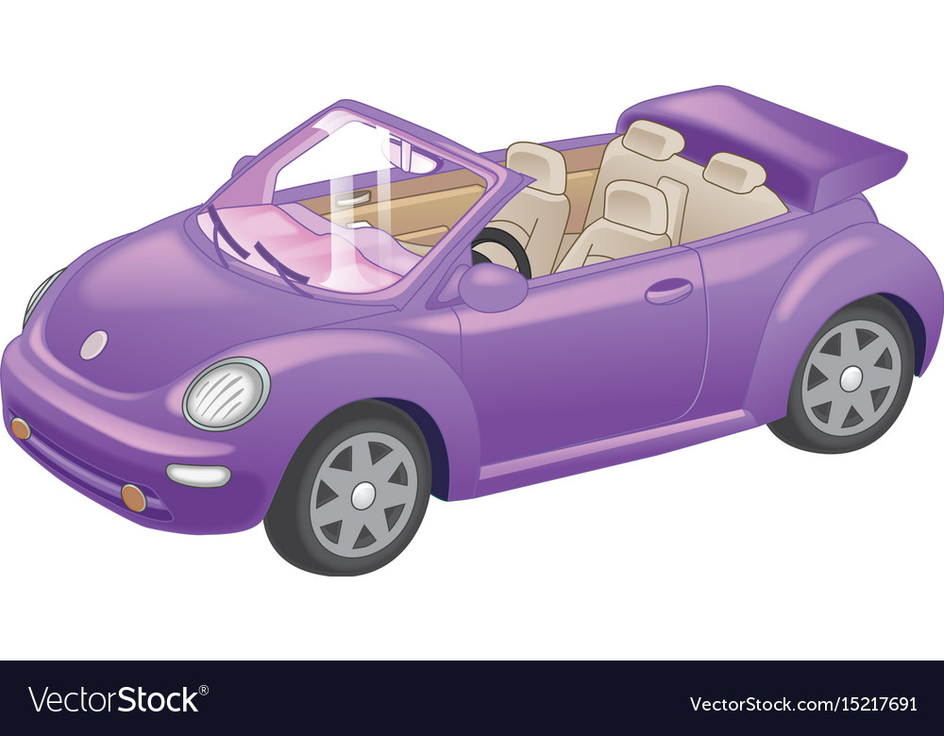

For this week's creative challenge we want you to make a rainbow in your own home! Can you find all the items in your house that are: red, orange, yellow, green, blue, indigo & violet and make them into the shape of a rainbow?
We would love to see your final rainbow!
Need help?
Here's a link to our example! https://www.youtube.com/watch?v=U9lKtLK_FVA

Slide 7
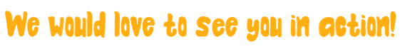
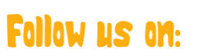



Twitter
@NWLSSP
Facebook
@northwestleicestershiressp
Instagram
@NWLSSP

