Slide 1
Woodstone Going Cashless
Welcome
Introduction - SchoolMoney
Time saving for school, flexible for parents, efficient for both
No Monday morning queues
Key Date: 3rd October 2016 – everything cashless
Notes:
Thank you for coming.
Rhea from SchoolMoney to answer any questions and guide us through the process.
Cashless payment processing will save administration time in school – most of the day on Mondays taken with manual cash handling for both Gill & Geraldine as well as payments made throughout the week.
Parents will be able to pay for dinners, trips, breakfast club, uniform at a time that suits them – so flexible

Slide 2
Woodstone Going Cashless
How it works
School sets up trips, etc. and parents receive a text notifying them of an activity to be paid
Click link in the text or go to www.schoolmoney.co.uk
Enter mobile number, email address and password in the text message
Click log in and enter child’s first name

Slide 3
Woodstone Going Cashless

Slide 4
Woodstone Going Cashless
Notes:
Payments Due Section
On your account page select the payment you wish to make
For trips you will have to give parental consent by clicking ‘ok’ in the pop up box before making payment
Select ‘Make Payment’ and you will be taken to a screen to input your card details
Select ‘Pay Now’ and you receive a confirmation and receipt
Card details are not stored on SchoolMoney system – details have to be entered at every payment

Slide 5
Woodstone Going Cashless

Slide 6
Woodstone Going Cashless
Notes:
Dinner & Breakfast Club Top-Up and School Shop
Section on the right side of your account page
Amounts highlighted green can be changed
Enter amount you want to pay, eg. Dinner money or Breakfast Club for a week, month or term
School Shop is for Uniform – Select the item and quantity
Select the tick box and click ‘Make a Payment’

Slide 7
Woodstone Going Cashless
Notes:
Pre-Booking Dinners
We have decided not to have the pre-booking dinners option as stated during the presentation. We cannot have pre-booking of dinner and top-up, it has to be one or the other and we have opted for top-up.
Children will still be able to choose their meal at register time as they do now and parents can pay an amount of their choosing– daily, weekly, monthly, termly amount - using the top-up facility.

Slide 8
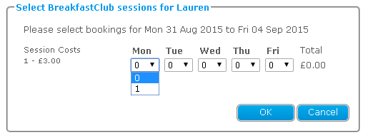
Woodstone Going Cashless
Notes:
Pre-Booking Breakfast Club
Log in to your account
Breakfast Club will be included in the left hand panel
Select the tick box next to the Breakfast Club you would like to book
A pop up appears for you to select the days of the week
Click OK and ‘Make payment’

Slide 9
Woodstone Going Cashless
Notes:
History
The History tab on the right hand side of account screen give an overview
Transaction history – all payments you have made to school

Slide 10
Woodstone Going Cashless
Notes:
Dinners Eaten – breakdown of meals taken, dinner money balance (credit/debit), what weeks are paid for or owing

Slide 11
Woodstone Going Cashless
Notes:
Dinners Booked – all meals you have pre-booked

Slide 12
Woodstone Going Cashless
Parents will still receive a letter giving full details of trips
Letters may not have consent forms
Residential, Breakfast Club, dinner money payments already made will be credited and actual balance outstanding entered
Barcodes issued to parents without internet access to use at PayPoints

Slide 13
Woodstone Going Cashless
Notes:
Barcodes are for specific child
Siblings have own barcodes so eg. pantomime will be 2 transactions
Be careful to use correct barcode – Dinner Money is paid directly to LCC account

Slide 14
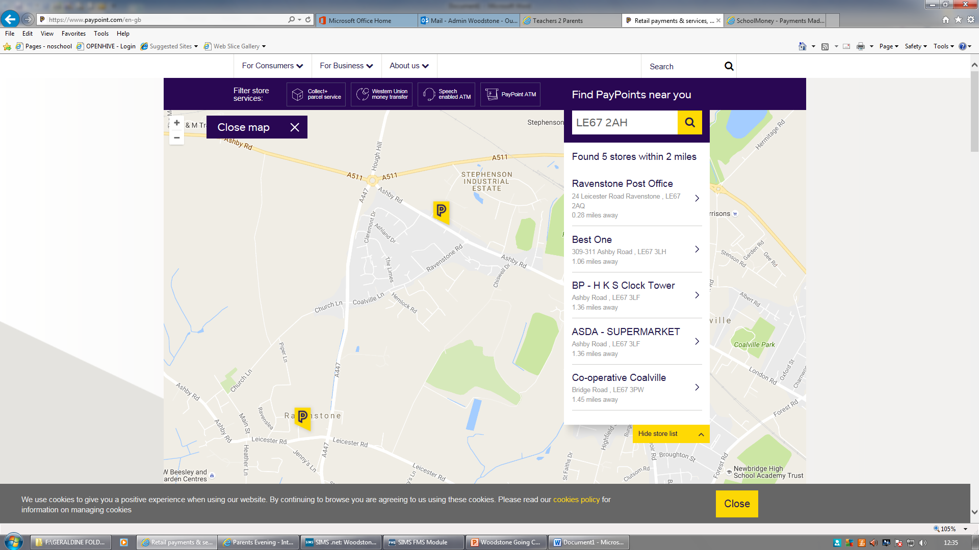
Woodstone Going Cashless

Slide 15
Woodstone Going Cashless
Breakfast Club must be pre-booked either via SchoolMoney or complete a booking form
Looking at installing a PC in the lobby for parents to use to make payments
Questions?

